Slide 1






Lecture 17:
Fetch API
Course - Web Development - II
-By
Instructor Name
Pratik Raj verma
‹#›
welcome@krmangalam.edu.in
Sohna Road,Gurugram,Haryana 122103

Slide 2

| Table of Contents
Fetch API
References.
The End.
‹#›

Slide 3
|
Imagine you go to a restaurant.You call the waiter and ask for your favorite food.The waiter goes to the kitchen, tells the chef, and then brings your food back to your table.Now think about websites… If our frontend (the table) wants something from the backend (the kitchen), do we also have a ‘waiter’ who takes our request and brings back the data?
‹#›

Slide 4
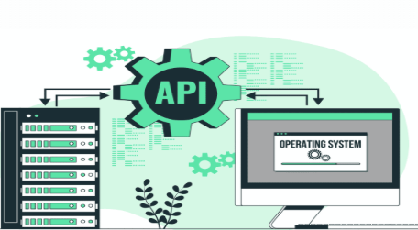
|
Imagine you go to a restaurant.You call the waiter and ask for your favorite food.The waiter goes to the kitchen, tells the chef, and then brings your food back to your table.Now think about websites… If our frontend (the table) wants something from the backend (the kitchen), do we also have a ‘waiter’ who takes our request and brings back the data?
Yes, we do! And in JavaScript, that waiter is called the Fetch API.
It takes our request to the server, waits for the response, and brings back the data we need
‹#›

Slide 5
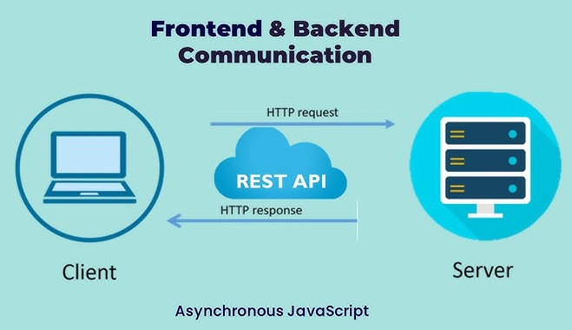
| Fetch API
Fetch API is a tool built into JavaScript that allows us to get data from the internet or send data to a server.
The fetch() function is the primary interface for making HTTP requests. It takes the URL of the resource as an argument which you want to fetch
It returns a Promise that resolves to the Response object
‹#›

Slide 6
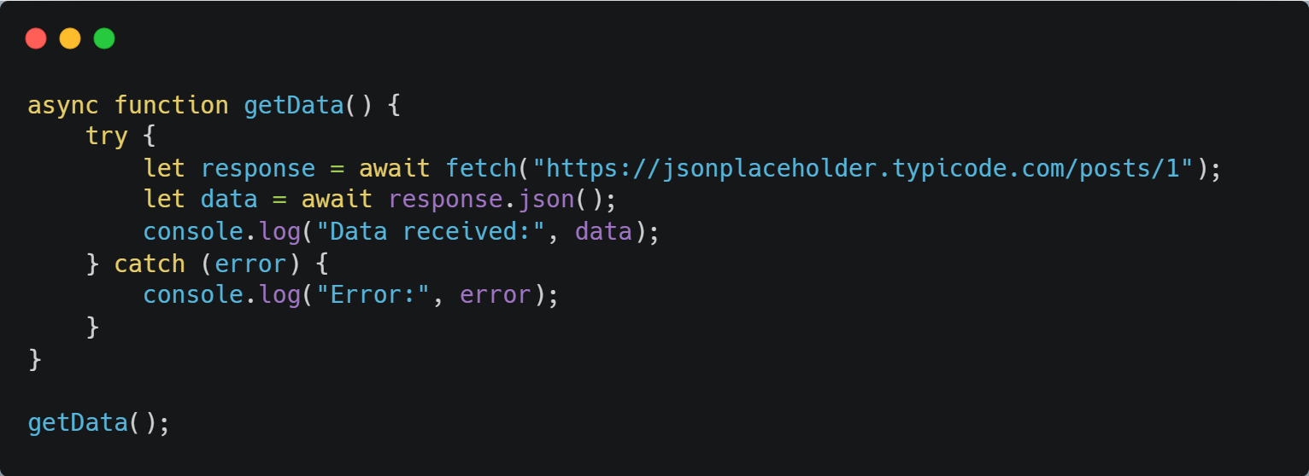
| Fetch API
Waiting for response
API url
waits to convert it into JavaScript object.
‹#›

Slide 7
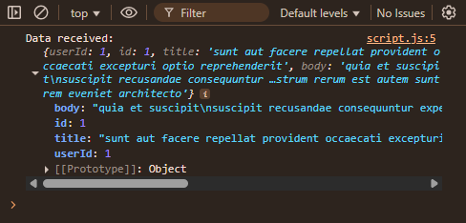
| Fetch API
Output
‹#›

Slide 8
| Fetch API
When we use fetch, data can travel in two directions:
1️⃣ From backend → frontend : GET Request
The frontend (browser or app) sends a GET request to the
backend asking for data.
2️⃣ From frontend → backend : POST Request
The frontend (browser or app) sends data to the backend using a POST request, usually to create or update something on the server.
‹#›

Slide 9
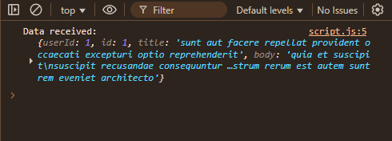
| GET request
Used when we want to get something from the backend.
Output
‹#›

Slide 10

| Coding Questions
1. Simple GET Request with fetch and await
Task :
Write an async function getTodo. Inside the function, use fetch and await to get data for a single "todo" item from the URL: https://jsonplaceholder.typicode.com/todos/1. After getting the response, use await again on the response.json() method to parse the data. Finally, log the parsed data.
‹#›

Slide 11
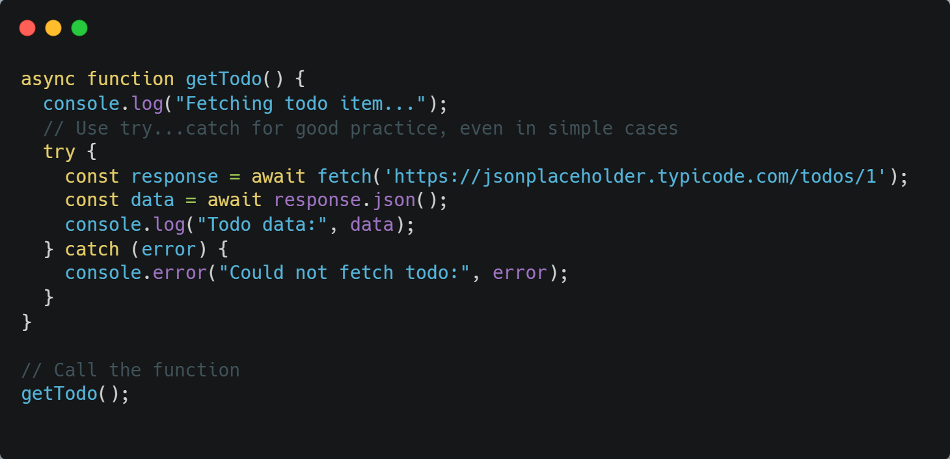
| Coding Questions
Solution :
‹#›

Slide 12
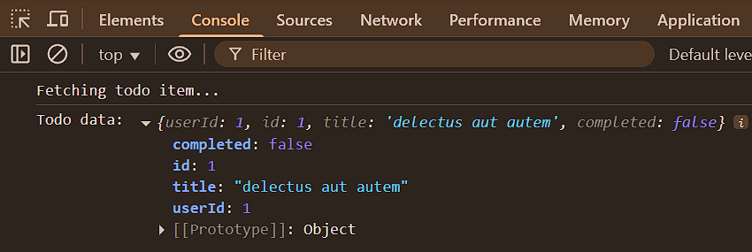
| Coding Questions
Output :
‹#›

Slide 13
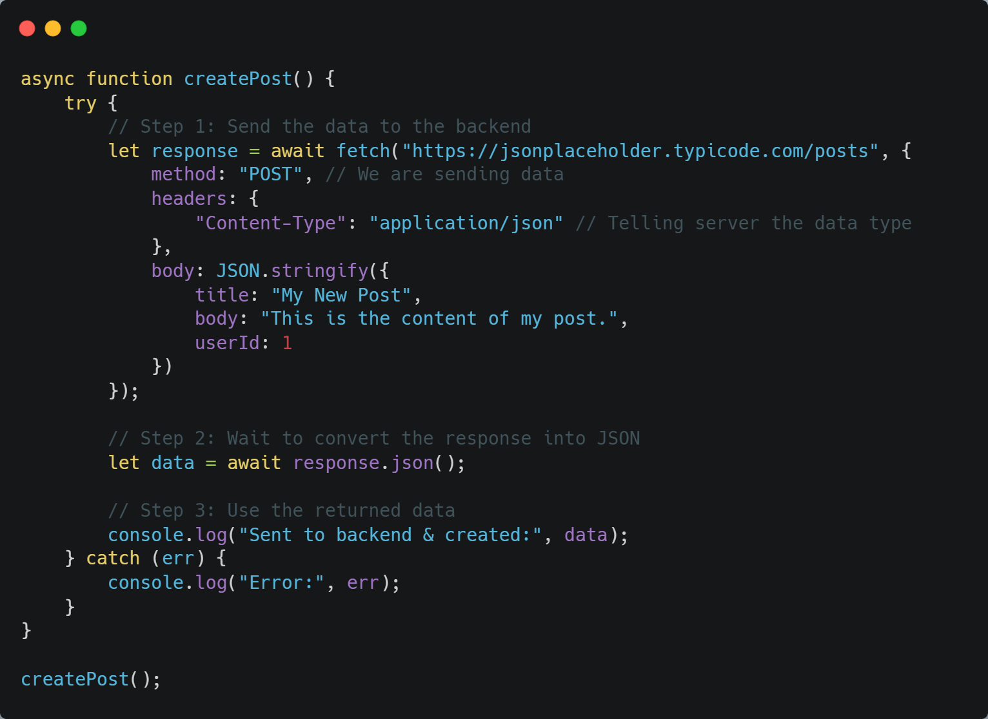
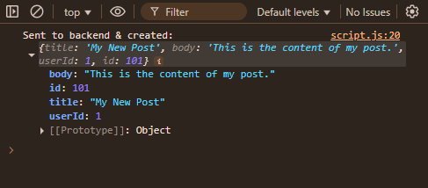
| POST request
Used when we want to send data from frontend to backend.
‹#›

Slide 14
| POST request
fetch() sends a POST request to the server with:
method = "POST" This tells the server that we are sending data (not just requesting it)
headers = These are extra instructions for the server. In this case, we tell the server that the data we’re sending is in JSON format
body = This is the actual data we are sending to the server. We write it in JSON format so that both the frontend and backend can understand it.
‹#›

Slide 15
| Check Your Understanding
Question : What does the fetch() function return?
Options : a) The JSON data directly.
b) A Promise that resolves to the Response object.
c) A callback function.
d) null if the request fails.
Answer : b) A Promise that resolves to the Response object.
Explanation:
fetch() initiates a network request and immediately returns a promise. This promise doesn't contain the data itself but a Response object that has methods to access the data.
‹#›

Slide 16
| Check Your Understanding
Question : When using fetch, what does the response.json() method do?
Options : a) It converts a JavaScript object into a JSON string.
b) It immediately returns the JSON data from the response.
c) It returns a Promise that resolves with the result of parsing the response body text as JSON.
d) It checks if the response is valid JSON.
Answer : c) It returns a Promise that resolves with the result of parsing the
response body text as JSON.
Explanation:
Reading the response body is also an asynchronous operation. response.json() starts the process and returns a promise that resolves once the body has been fully read and parsed into a JavaScript object.
‹#›

Slide 17
| References
MDN Web Docs : Comprehensive and official documentation for JS. 🔗https://developer.mozilla.org/en-US/docs/Web/JavaScript
W3Schools – JS Tutorial : Beginner-friendly JS tutorials with examples and interactive editors. 🔗 https://www.w3schools.com/js/
JavaScript.info - A comprehensive tutorial-style website that covers core JavaScript concepts in depth.
🔗https://javascript.info/
‹#›

Slide 18

Thanks
For
Watching
Course - Web Development - II
‹#›
welcome@krmangalam.edu.in
Sohna Road,Gurugram,Haryana 122103

